Slide 1
Early initiation of ART in in-utero HIV-infected infants;
THE POTENTIAL FOR CURE
Cepheid Symposium, IAS
23rd July 2018

Slide 2
Conflict of interest
Conference attendance supported by Cepheid®

Slide 3
Background
Perinatal HIV-1 infection
Early ART
Post-treatment control
Mississippi Baby
Visconti Child
South African Child

Slide 4
Greater intrinsic potential for HIV remission/cure in paediatric infection by treating early?

Slide 5
Very early (<48h) ART initiation in in-utero HIV-infected infants
Aims
  Feasibility
  Determine the potential for cure/remission
  Define factors contributing to cure/remission

Slide 6
Very early (<48h) ART initiation in
in-utero HIV-infected infants
Aims
  Feasibility
  Determine the potential for cure/remission
  Define factors contributing to cure/remission

Slide 7


Setting
Maternal HIV seroprevalence
39.2%
Empangeni
Stanger
Edendale
MGMH
Durban

Slide 8
Study outline
2778 (17%)
Infants high risk IU HIV-1
70
HIV-1 TNA/RNA PCR positive
66
confirmed infected
ART initiated
Median time 26h
IQR 18-40

Slide 9
Study outline
Routine government testing infants
55
HIV-1 TNA PCR positive
21
HIV-1 TNA PCR indeterminate
57
confirmed infected
ART initiated
Median time 10d
IQR 8.5-14

Slide 10
Study outline
2778 (17%)
Infants high risk IU HIV-1
Routine government testing infants
70
HIV-1 TNA/RNA PCR positive
55
HIV-1 TNA PCR positive
21
HIV-1 TNA PCR indeterminate
66
confirmed infected
ART initiated
Median time 26h
IQR 18-40h
57
confirmed infected
ART initiated
Median time 10d
IQR 8.5-14d
123

Slide 11
30% mothers acutely infected
Timing Maternal of HIV infection

Slide 12
30% mothers acutely infected
Timing Maternal of HIV infection
Perinatal

Slide 13
Mothers non-adherent to ART

Slide 14
Infant initial CD4 counts healthy

Slide 15
Median initial infant viral load 10,000c/mL

Slide 16
Increasing diagnostic uncertainties in infants with in-utero HIV infection; the benefits of point-of-care testing at birth

Slide 17
Case 1
Acute HIV infection in pregnancy
Term baby boy, NVP/AZT prophylaxis
GeneXpert HIV-qual “HIV-1 detected” Ct 41.8
ART initiated 16h

Slide 18
Case 1
Birth test dried blood spot indeterminate
Repeat on day 16 negative
Viral load at 12h age 1100 HIV RNA copies/mL

Slide 19
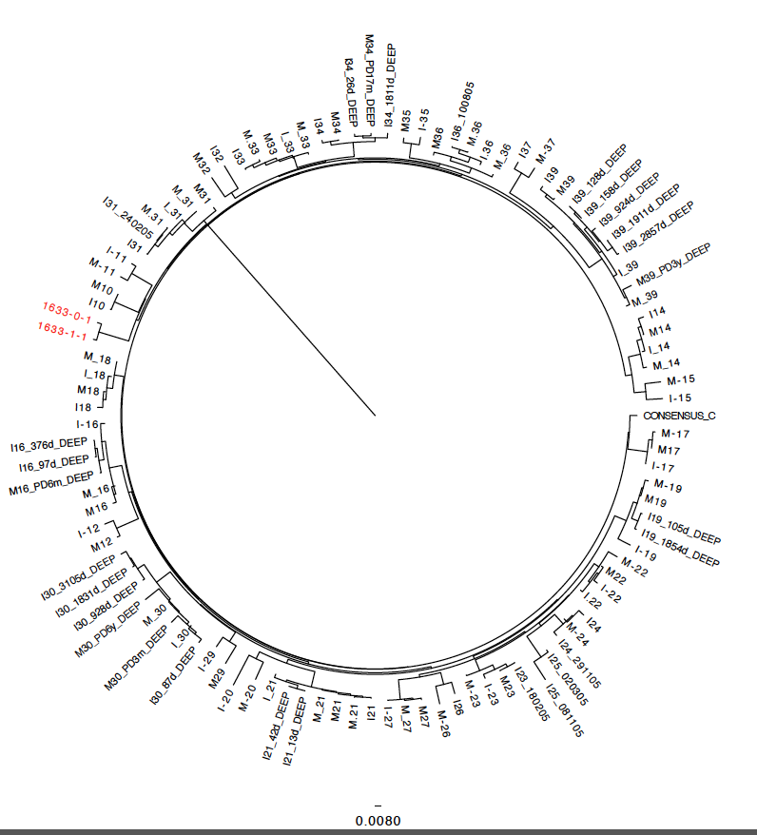

Slide 22
Case 2
Maternal ART non-adherence
Term baby girl, NVP prophylaxis
GeneXpert HIV-qual “HIV-1 detected” Ct 41.3
ART initiated 20h

Slide 27
Conclusion cases
PMTCT strategies → IU infection more difficult to diagnose
Confirmatory testing is imperative (1)
Point-of-care testing at birth may resolve this
1. Dunning et al. The value of confirmatory testing in early infant HIV diagnosis programmes in South Africa: A cost-effectiveness analysis. PLOS Med. 2017;14(11):e1002446

Slide 28
Median time to viral suppression 4.8months
Excluded infants: suppressed at birth, did not return for 28d visit and those <6months of age

Slide 29
No difference for those treated very early

Slide 30
Median time to rebound 12 months
57% did not regain suppression

Slide 31
ART resistance
NNRTI resistance
– some transmitted
M184V mutation common
No protease inhibitor resistance found

Slide 32
Conclusions
In-utero ART exposure =
initial low viral loads in HIV-infected infants
Point-of-care testing is useful in this setting
BUT….

Slide 33
Conclusions
In-utero ART exposure =
initial low viral loads in HIV-infected infants
Point-of-care testing is useful in this setting
BUT….
Major challenges to achieving ART adherence in children whom MTCT has arisen as a result of maternal non-adherence

Slide 34





Acknowledgements
Children and their families
Ucwaningo Lwabantwana team

